Slide 1


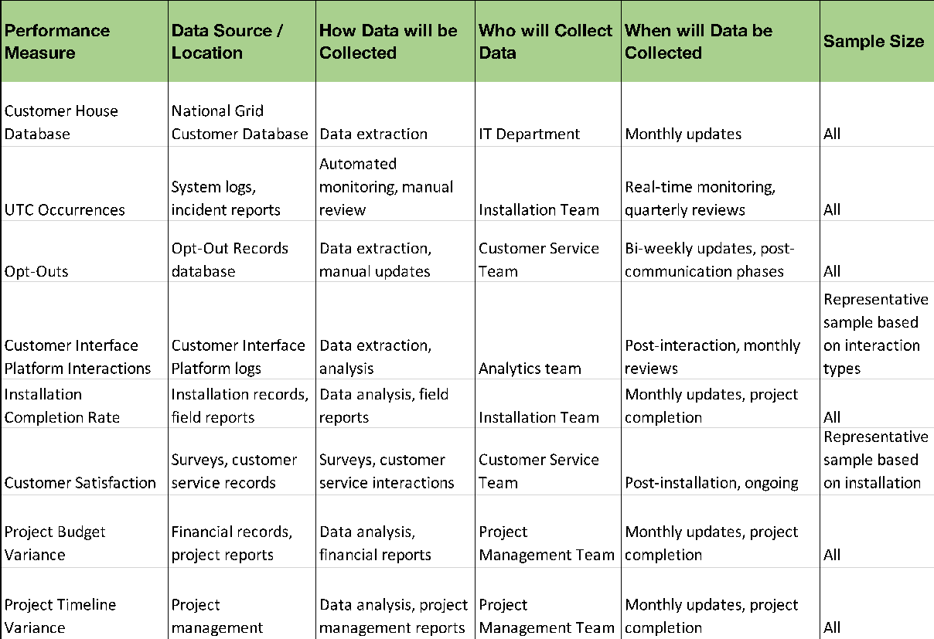
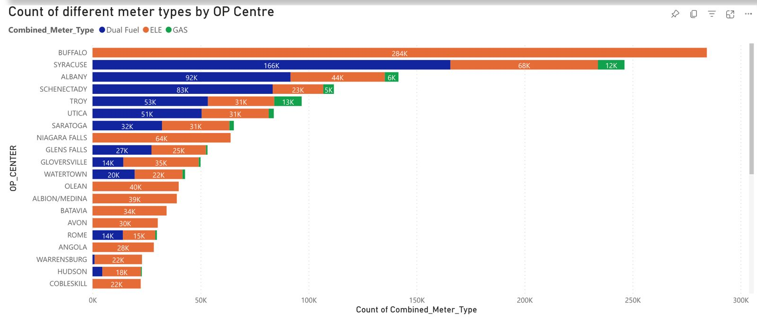
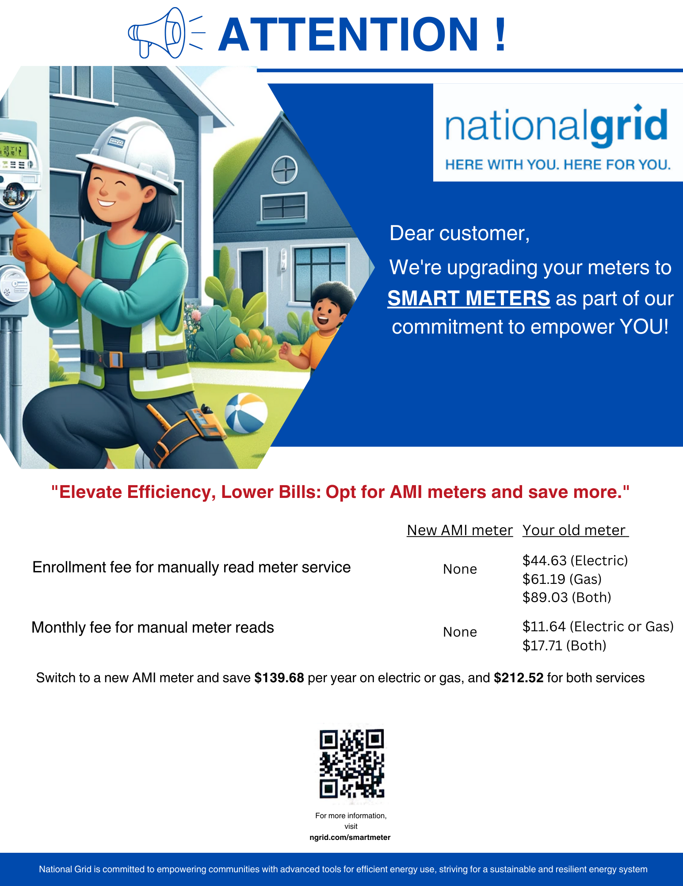
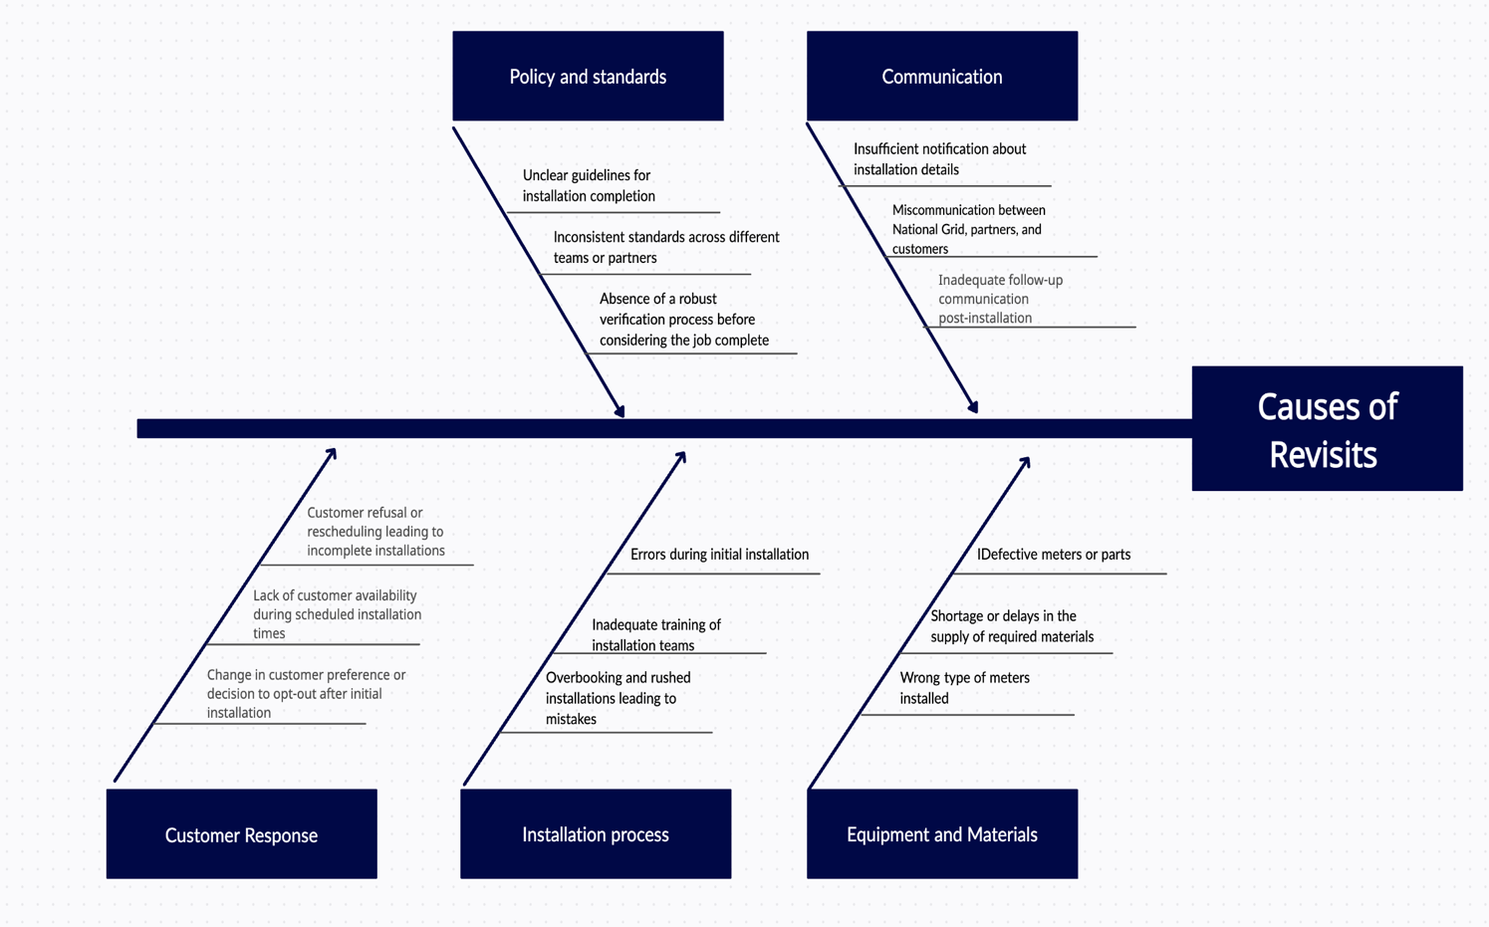
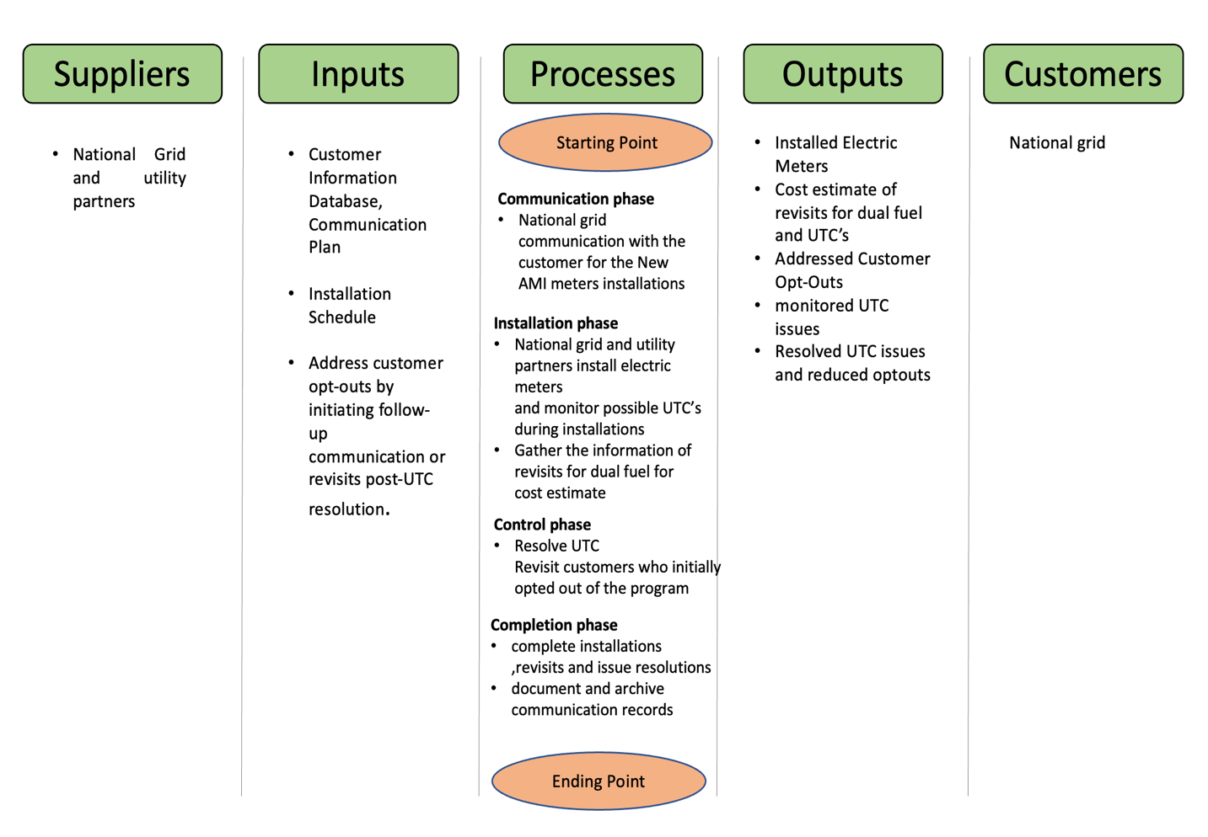
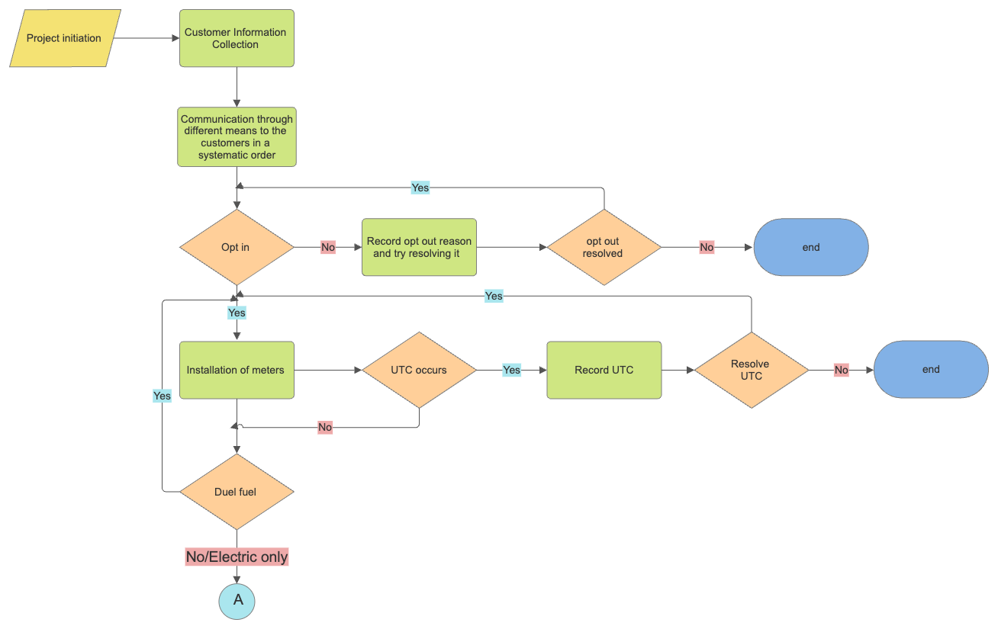
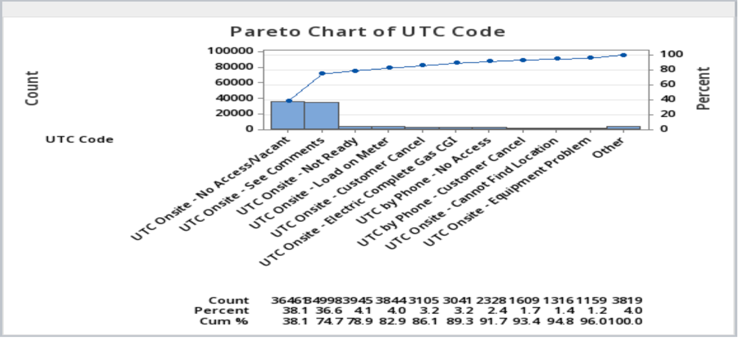
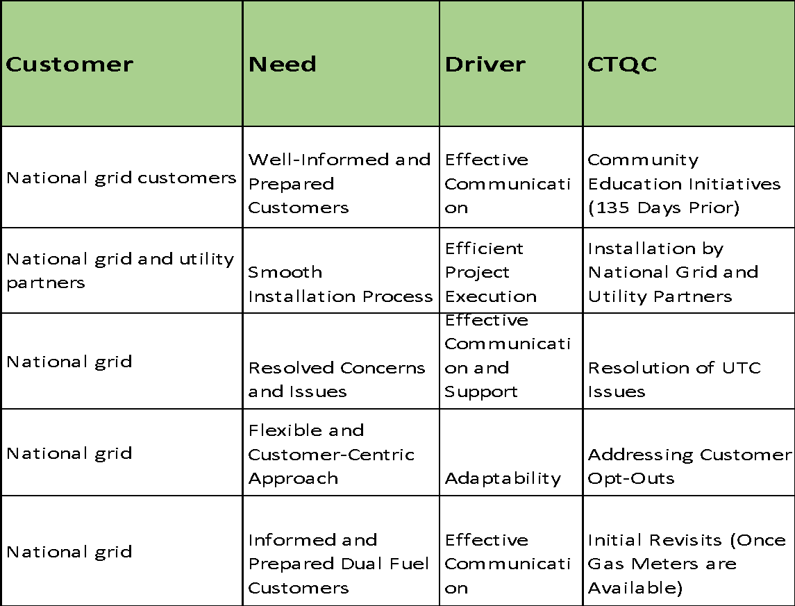
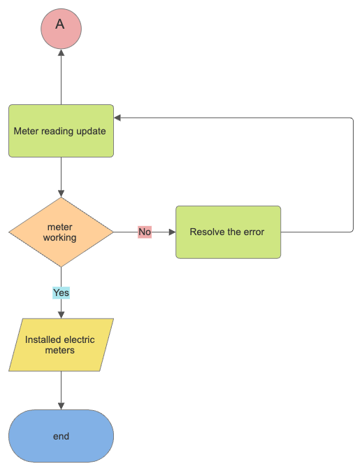
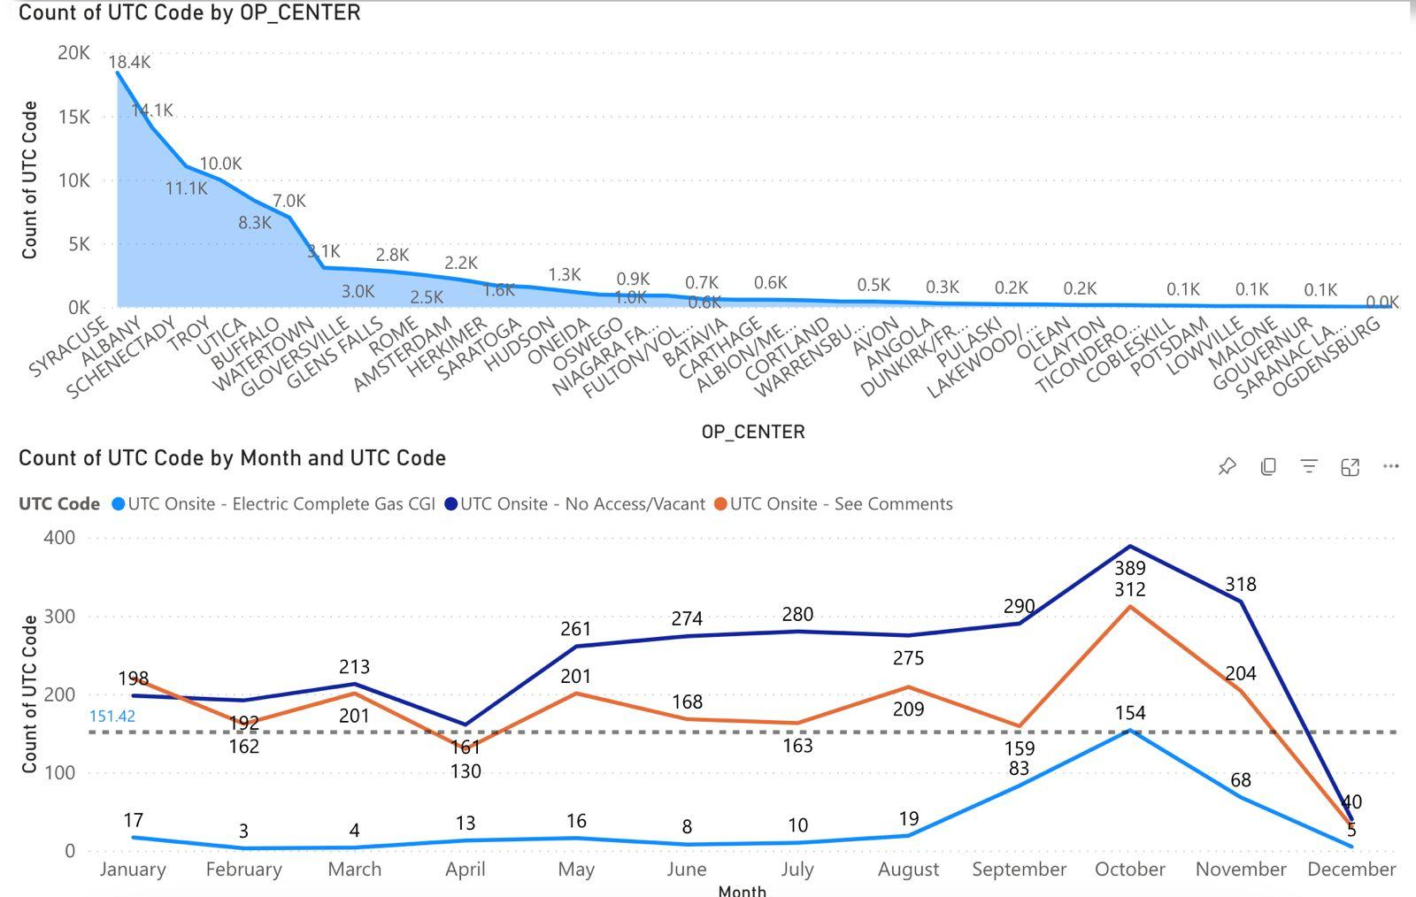
CMS (Customer Meter Service) Resource Optimization
INSTRUCTOR: Prof. Gary La Point, PROJECT CHAMPION: James Walter
TEAM: Nandita Pathardikar, Anjana Sowmya Puvvada, Shweta Khopde, Umang Vora
PROBLEM STATEMENT:
National Grid and Utility Partners encounter obstacles with delayed Gas Module availability, resulting in costly return visits for Dual Fuel and Gas-only customers. The escalation of UTC rates, in conjunction with an increasing number of customer opt-outs prior to installations, compounds project costs. Balancing installations in overlapping areas becomes critical to optimize resources and enhance operational efficiency from September 2023 to November 2024.
GOAL:
Our goal is to optimize costs by enhancing resource allocation and operational efficiency, coupled with streamlined communication to improve decision-making and reduce overheads.
SIPOC :
CTQC TREE :
DEFINE
In a single-visit scenario, the efficient installation of meters incurs a total cost of $19.74 million, encompassing dual fuel, electric, and gas meters. However, the financial impact of revisits, primarily for dual fuel installations due to gas module unavailability, substantially raises project costs by an additional $13.31 million
Communicate the costs associated with opting out in
Reassure customers about the safety of the new meters
Implement a step-wise opt-out process that requires customers to apply for opt-out
MEASURE
IMPROVE
DATA COLLECTION PLAN
PROCESS FLOW MAP
ANALYZE
Meter Type Distribution Analysis
CAUSE AND EFFECT DIAGRAM
CONTROL
Elimination of Revisits saves $13.31 million.

Slide 2
CMS (Customer Meter Service) Resource Optimization
INSTRUCTOR: Prof. Gary La Point, PROJECT CHAMPION: James Walter
TEAM: Nandita Pathardikar, Anjana Puvada, Umang Vora, Shweta Khopde
ABOUT NATIONAL GRID
National Grid and Utility Partners of America (UPA) are initiating a project to install approximately 830,000 electric meters across Central New York from September 2023 to November 2024. Unforeseen delays in Gas Module availability from the supplier, Landis and Gyr, have necessitated return visits to Dual Fuel customers and initial visits to Gas-only customers in close proximity who were initially skipped. This project aims to assess the costs associated with these return visits, considering increased UTC rates and addressing opt-outs from customers despite varied communication efforts.
PROBLEM STATEMENT:
National Grid and Utility Partners encounter obstacles with delayed Gas Module availability, resulting in costly return visits for Dual Fuel and Gas-only customers. The escalation of UTC rates, in conjunction with an increasing number of customer opt-outs prior to installations, compounds project costs. Balancing installations in overlapping areas becomes critical to optimize resources and enhance operational efficiency from September 2023 to November 2024.
GOAL:
Our goal is to optimize costs by enhancing resource allocation and operational efficiency, coupled with streamlined communication to improve decision-making and reduce overheads.
SIPOC
CTQC TREE
DEFINE
MEASURE
CAUSE AND EFFECT DIAGRAM
IMPROVE
DATA COLLECTION PLAN
PROCESS FLOW MAP
ANALYZE

